Slide 1

Sexual Identity
Think of factors from Model of Sexual Being
  Gender identity
  Gender role
  Biological sex
  Sexual orientation

Slide 2
SEXUAL ORIENTATION
Includes erotic, romantic, & affectional
Different than just behavior
Traditional breakdown includes:
  Heterosexual - to the other sex
  Homosexual - to the same sex
  Bisexual - to both sexes
Notes:
MERRIAM WEBSTER DEFINITIONS:
Main Entry: erot·ic Function: adjective
1 : of, devoted to, or tending to arouse sexual love or desire <erotic art>
2 : strongly marked or affected by sexual desire
- erotic noun erot·i·cal·ly /-ti-k(&-)lE/ adverb
Main Entry: ¹ro·man·tic Function: adjective
1 : consisting of or resembling a romance
2 : having no basis in fact : IMAGINARY
3 : impractical in conception or plan : VISIONARY
4 a : marked by the imaginative or emotional appeal of what is heroic, adventurous, remote, mysterious, or idealized b often capitalized : of, relating to, or having the characteristics of romanticism c : of or relating to music of the 19th century characterized by an emphasis on subjective emotional qualities and freedom of form; also : of or relating to a composer of this music
5 a : having an inclination for romance : responsive to the appeal of what is idealized, heroic, or adventurous b : marked by expressions of love or affection c : conducive to or suitable for lovemaking
6 : of, relating to, or constituting the part of the hero especially in a light comedy
- ro·man·ti·cal·ly /-ti-k(&-)lE/ adverb
Main Entry: af·fec·tion·al Function: adjective Date: 1859
: of or relating to the affections
Main Entry: af·fec·tion Function: noun
1 : a moderate feeling or emotion
2 : tender attachment : FONDNESS <she had a deep affection for her parents>
3 a (1) : a bodily condition (2) : DISEASE, MALADY b : ATTRIBUTE <shape and weight are affections of bodies>

Slide 3
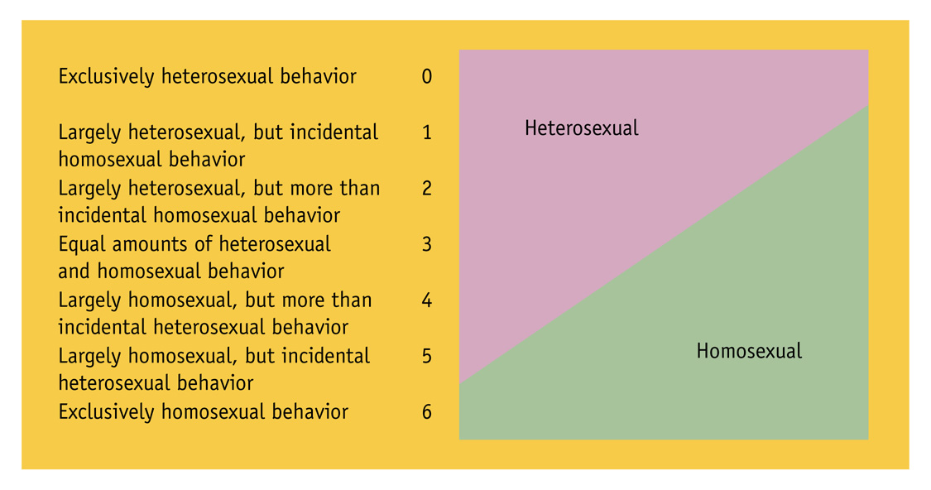
KINSEY CONTINUUM
Notes:
Explain Kinsey continuum: 7-point spectrum of sexual orientation

Slide 4
Klein Sexual Orientation Grid
Expands beyond (Kinsey and) behavior to include:
  Sexual Attraction
  Sexual Behavior
  Sexual Fantasies
  Emotional Preference
  Social Preference
  Lifestyle Preference
  Self Identification
  Political Identity
Also considers time
  Past: Your life up to 12 months ago.
  Present: The most recent 12 months
  Ideal: What do you think you would eventually like?
Notes:
Sexual Attraction: To whom are you sexually attracted?
Sexual Behavior: With whom have you actually had sex?
Sexual Fantasies: Whom are your sexual fantasies about? (They may occur during masturbation, daydreaming, as part of real life, or purely in your imagination.)
Emotional Preference: Emotions influence, if not define, the actual physical act of love. Do you love and like only members of the same sex, only members of the other sex, or members of both sexes.
Social Preference: Social preference is closely allied with but often different from emotional preference. With members of which sex do you socialize?
(different reference point descriptions are used for the remaining aspects.)
Lifestyle Preference: What is the sexual identity of the people with whom you socialize? (Add "All" as a choice for each scale on this card.)
Sexual Identity: How do you think of yourself?
Political Identity: Some people describe their relationship to the rest of society differently than their personal sexual identity. For instance, a woman may have a heterosexual sexual identity, but a lesbian political identity. How do you think of yourself politically?

Slide 5
Klein Sexual Orientation Grid
More info
  http://www.americaninstituteofbisexuality.org/thekleingrid/
Complete the scale
  https://bi.org/en/klein-grid

Slide 6
Points from the Klein Scale
Sexual orientation – may not consistent with sexual behavior
Fluidity of sexual orientation
Other terms:
  Ambisexual – person whose sexual relationships fluctuate from same-sex to other sex partners
  Pansexual (Omnisexual) - Relating to, having, or open to sexual activity of many kinds
Notes:
Sexual identity (how people think of themselves) sometimes has little to do with their sexual behavior. Three different people may have the same distribution of sexual behavior in the past and/or present, but have three different sexual identities: homosexual, bisexual, or heterosexual. This may be confusing at first, but is important to remember. This point is often useful in helping people to understand that just because someone has a different sexual identity does not necessarily mean that that person's sexual behavior is different from their own. Conversely, the fact that someone else has the same sexual identity does not mean that that person's sexual behavior is the same as their own.
People who think of themselves as bisexual, heterosexual, or homosexual may find they are quite similar in some aspects and different in others. For example, in choosing people to spend time with in social activities, most women hang out with women and most men hang out with men. That is, both women and men show a social preference for members of the same sex. According to many national surveys, whether their sex is male or female, and whether their sexual identity is homosexual, bisexual, or heterosexual, most people have an emotional preference for women as close friends. We may all be more alike than we think.
In some areas, the Lesbian and Gay male communities take the position that bisexuals are not welcome in the Lesbian and Gay communtites, that they do not exist, and/or that they are "traitors to the cause" and "sleeping with the enemy." This collection of attitudes is often termed "biphobia." It usually occurs with greater frequency and virulence in Lesbian communities, where it is associated with negative feelings about and political action against patriarchy and women's oppression. It is also clearly present in Gay male communities, often in the more subtle form of deprecation and ridicule of bisexual identity. In biphobic communities, an individual who might otherwise identify as bisexual may choose to suppress attractions to and activities with one gender or the other in order to identify as either heterosexual or homosexual. Alternatively, a person may switch back and forth, trying alternately to identify as homosexual or heterosexual.

Slide 7
Growing use of “Asexual”
Asexual: A person who does not experience sexual attraction
Some have no interest in intimacy or sexual experience while some still “like” others and want intimate relationships
One study showed about 1% of individuals are asexual
Resource: Asexual Visibility and Education Network http://www.asexuality.org
Notes:
Anthony Bogaert, Journal of Sex Research Oct. 2004 looked at research from 1994
http://www.newscientist.com/article.ns?id=dn6533
From article: http://www.slweekly.com/editorial/2004/feat_2004-09-16.cfm
Type A—Do not experience romantic attraction, but are able to get aroused. They have no drive to engage in sex. In other words, they’re stuck in neutral.
Type B—Experience romantic attraction, but have no sex drive. They want to explore, but the stick shift is jacked.
Type C—Capable of both arousal and romantic attraction, but have no drive to put the two together. There just isn’t enough gas.
Type D—Feel neither attraction nor arousal. This is the most common type of asexual. These people prefer to avoid driving altogether.
While the system is helpful for identifying different levels of asexuality, it doesn’t explain how those conditions surfaced. Most researchers can only describe asexuality through better-established conditions.
Donald Strassberg, a University of Utah psychology professor whose research interests include sexual function and sexual dysfunction, thinks asexuality could be explained by two different—but likely related—disorders. The first one, hypoactive sexual desire disorder (HSDD), pertains to individuals who, given the opportunity to have sex, will either pass or take it without applause.
Sexual Aversion Disorder (SAD), on the other hand, describes those who go out of their way to avoid intercourse. In this case, sex and pleasure exist as polar opposites. There is no middle ground, no occasional hanky-panky for the sake of others.

Slide 8
Cause of sexual orientation
Nothing definitive related to genetic, hormonal, developmental, social and cultural influences
Nature and nurture both play complex roles; most people experience little or no sense of choice
Reparative therapy – “changing sexual orientation” not supported by mental health orgs
  Some states making illegal for children
Notes:
Biological theories:
Genetic theory - genes and chromosonal
Hormonal theory – hormonal imbalance during prenatal or after birth, excess androgen – lesbian, low levels of androgen – gay male, DES during pregnancy -- lesbian
Psychological theories:
Psychoanalytic theory – -- overprotective mom, Oedipus complex by Freud, poor methodology
Learned behavior theory – not supported
Two Landmark studies:
Simon LeVay (1991)
Swaab and Hoffman (1990)

Slide 9
Language of Sexual Minorities
GLBTTIQQAA
  Gay
  Lesbian
  Bisexual
  Transgender
  Transsexual
  Intersex
  Queer
  Questioning
  Ally
  Asexual
Notes:
Be sure to know terms
Realize that these do not all refer to sexual orientation

Slide 10
Prejudice and Discrimination
Homophobia
Homonegativism
Heterosexism
Biphobia
  Dual marginalization
Notes:
Homophobia – irrational fear of homosexuality
Homonegativism - negative attitude towards homosexuality or homosexual people
Heterosexist – attitude that reinforces heterosexuality as the privileged and powerful norm

Slide 11
Coming out
Process
  Acknowledging
  Accepting
  Openly expressing one’s orientation
Can influence and be influenced by other identities
  Ethnic, religious, gender
Notes:
Acknowledging
Accepting
Openly expressing one’s homosexuality

Slide 12
Consider this…
If you’re straight, how you would answer these questions:
  What do you think caused your heterosexuality?
  When and how did you decide you were a heterosexual?
  Is it possible that your heterosexuality is just a phase you may grow out of?
  If you’ve never slept with a person of the same sex, is it possible that all you need is a good gay lover?
  The majority of child molesters are heterosexual. With that in mind, do you consider it safe to expose your child to heterosexual teachers?

Slide 13
Legal Issues
Same sex sexual activities legal – Lawrence v TX (2003)
State Maps - https://www.hrc.org/resources/state-equality-index
  Discrimination for employment & housing
  Parenting laws
  Hate crime laws
Notes:
June 26, 2003, the U.S. Supreme Court handed down its decision in Lawrence v. Texas, finding sodomy laws to be discriminatory and unconstitutional.
The Lawrence v. Texas case is based on an incident in September 1998, when Houston police broke into John Lawrence's apartment while responding to a false report of an armed intruder. They found Lawrence having sex with Tyron Garner and jailed both men under a state law banning sex between consenting adults of the same sex, but not of the opposite sex. The two pleaded no contest to the misdemeanor charge and were each fined $200. The state courts upheld the conviction, which - if allowed to stand - could harm the lives of both men by labeling them as convicts and sex offenders.

Slide 14
Open GLB Youth
0
Possible Family Rejection & School Dangerous
  Thrown out of home
  Mistreated or made focus of family's dysfunction.
  25-40% of homeless youth may be GLB
  Verbal & physical harassment
Notes:
(reporting findings from one study unless otherwise indicated)
The consequences of physical and verbal abuse directed at GLBT students include truancy, dropping out of school, poor grades, and having to repeat a grade. In one study, 28 percent of gay and bisexual youth dropped out of school due to peer harassment.4
Open GLB Identity --> Possible Family Rejection & School Dangerous.
Thrown out of home, mistreated or made the focus of the family's dysfunction.
25-40% of homeless youth may be GLB
National study of GLBT students
83% reported verbal harassment
21% reported being punched, kicked, or injured with weapon at school b/c of sexual orientation.
28% of GLB youth dropped out due to peer harassment.
GLSEN 2003 REPORT
Unchecked harassment correlates with poor performance and diminished aspirations: LGBT youth who report significant verbal harassment are twice as likely to report they do not intend to go to college and their GPAs are significantly lower (2.9 vs. 3.3).
Supportive teachers can make a difference: 24.1% of LGBT students who cannot identify supportive faculty report they have no intention of going to college. That figure drops to just 10.1% when LGBT students can identify supportive staff at their school.
Policymakers have an opportunity to improve school climates: LGBT students who did not have (or did not know of) a policy protecting them from violence and harassment were nearly 40% more likely to skip school because they were simply too afraid to go.
Harassment continues at unacceptable levels and is too often ignored: 84% of LGBT students report being verbally harassed because of their sexual orientation. 82.9% of students report that faculty never or rarely intervene when present. GLSEN’s National School Climate Survey is the only national survey to document the experiences of LGBT students in America’s schools and has been conducted bi-annually since 1999. The 2003 survey includes responses from 887 LGBT middle and high school students from 48 states and the District of Columbia.

Slide 15
YRBS data on LGB youth - 2015
10% - threatened or injured with weapon on school property
34% - bullied on school property
28% - bullied electronically
23% of those who had dated or went out with someone during the 12 months before the survey had experienced sexual dating violence in the prior year
18% - experienced physical dating violence
18% - had been forced to have sexual intercourse at some point in their lives.
Notes:
Reference: https://www.cdc.gov/lgbthealth/youth.htm

Slide 16
GLBT Youth of Color
0
Additional Challenges
Many ethnic minority communities reinforce negative ideas.
Almost ½ GLBT youth of color experience physical violence & verbal harassment
Notes:
In past, GLBT okay in Native American communities, not true today
In many Latino communities, machismo and Catholicism contribute to homophobic attitudes that hamper efforts to reach Latino gay and bisexual youth with HIV prevention information.
Asian American and Pacific Islander GLBT youth often feel that they have shamed their families when they diverge from cultural expectations to marry and have children.
African American GLBT youth often face discrimination from white gay communities and rejection from homophobic black communities.
46% GLBT youth of color experience physical violence b/c of SO
48% of youth - verbally harassed in school b/c of SO & race/ethnicity.

Slide 17
Association with health
Lesbians/bisexual female youth more likely to use cigarettes & marijuana
Bisexual females also more likely to use alcohol
Lesbians, bisexual females & females unsure of their identity had higher cocaine, heroin, methamphetamines, ecstasy, & inhalant use
Notes:
Pooled data from 2015-2017 YRBS - https://www.cdc.gov/mmwr/volumes/67/wr/mm6743a4.htm?s_cid=mm6743a4_e)

Slide 18
Association with health - 2
Bisexual males more likely to use cigarette
Compared to heterosexual males, cocaine, heroin, methamphetamines, ecstasy, & inhalant use higher among gay, bisexual and males unsure of their sexual identity
Sexual minority females and males reported feeling sad or hopeless, considering attempting suicide, making a suicide plan, and attempting suicide more than their heterosexual peers

Slide 19
Few + Role Models
0
Learn from TV, movies and media how to be “lesbian” or “gay”
While more people visible, often because of consumerism issues
Internalized homophobia
Changing legal issues
It Gets Better
  http://www.itgetsbetter.org/
Notes:
GLBT youth often internalize negative societal messages regarding sexual orientation and suffer from self-hatred as well as social and emotional isolation. They may resort to substance use in attempts to manage stigma and shame, to deny same-sex sexual feelings, or as a defense against ridicule and violence.
A study of public high school students found that GLB students were significantly more likely to use crack cocaine, cocaine, anabolic steroids, and inhalants than were their heterosexual peers.

Slide 20
Resources
The Gay, Lesbian and Straight Education Network (GLSEN) http://www.glsen.org
Human Rights Campaign (HRC) http://www.hrc.org
PFLAG http://www.pflag.org
Bisexual Resource Center (BRC) http://www.biresource.org
National Gay and Lesbian Task Force http://www.ngltf.org
Gay and Lesbian Medical Association (GLMA) http://www.glma.org
Campus Index - https://www.campusprideindex.org/

Slide 21
Importance of Support
https://www.youtube.com/watch?v=EpfLklSG2dQ&feature=emb_logo

